Slide 1
UCF COURSE MATERIALS ADOPTION PROCESS
Instructions on submitting adoptions through the Adoptions and Insights Portal (AIP)

Slide 2
UCF’s Official System of Record
AIP is a web-based platform built exclusively for faculty and department administrators to research and adopt textbooks and course materials in one, convenient place. The portal populates course schedule information from UCF’s student information system (SIS), based on which AIP delivers a highly personalized, streamlined, action-oriented user experience for faculty, staff, administrators, and academic leadership.
Key functionalities include:
a personalized course list for faculty and staff to easily search, research, and submit their adoptions.
historic adoption data and one-click re-adoption functionalities.
a dashboard to track, monitor, and report on timely adoption submissions in real time.
in-line affordability recommendations for open educational resources and other options as a complement or substitute to traditional course materials.
communication tools, including automated reminders, on-demand emails, and onsite messaging.
24/7 adoption support via website chat or toll-free number as well as the option to directly communicate with the Barnes & Noble bookstore staff on the local campus.
integration with UCF’s student information system for an efficient, personalized and real-adoption process.
AIP is UCF’s official system of record for reporting all instructional materials at UCF. All instructional materials including textbooks, access codes, digital materials, OER, UCF Library resources, and required school supplies need to be recorded for each course at UCF. If a course is not using any instructional materials, that course needs to be listed as “no materials required” in AIP.
UCF Campus Store

Slide 3
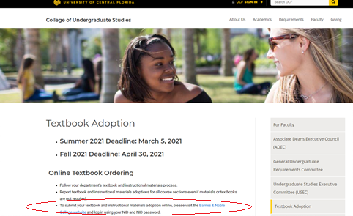
Adopting Course Materials
Click on the link found on the College of Undergraduate Studies website for textbook adoptions
Go to "Online Textbook Ordering"- Find the bullet point that states: "To submit your textbook and instructional materials adoption online, please visit the Barnes & Noble College website and log in using your NID and NID password“
Click on the Barnes and Noble College Website link
Or visit aip.bncollege.com
UCF Campus Store

Slide 4
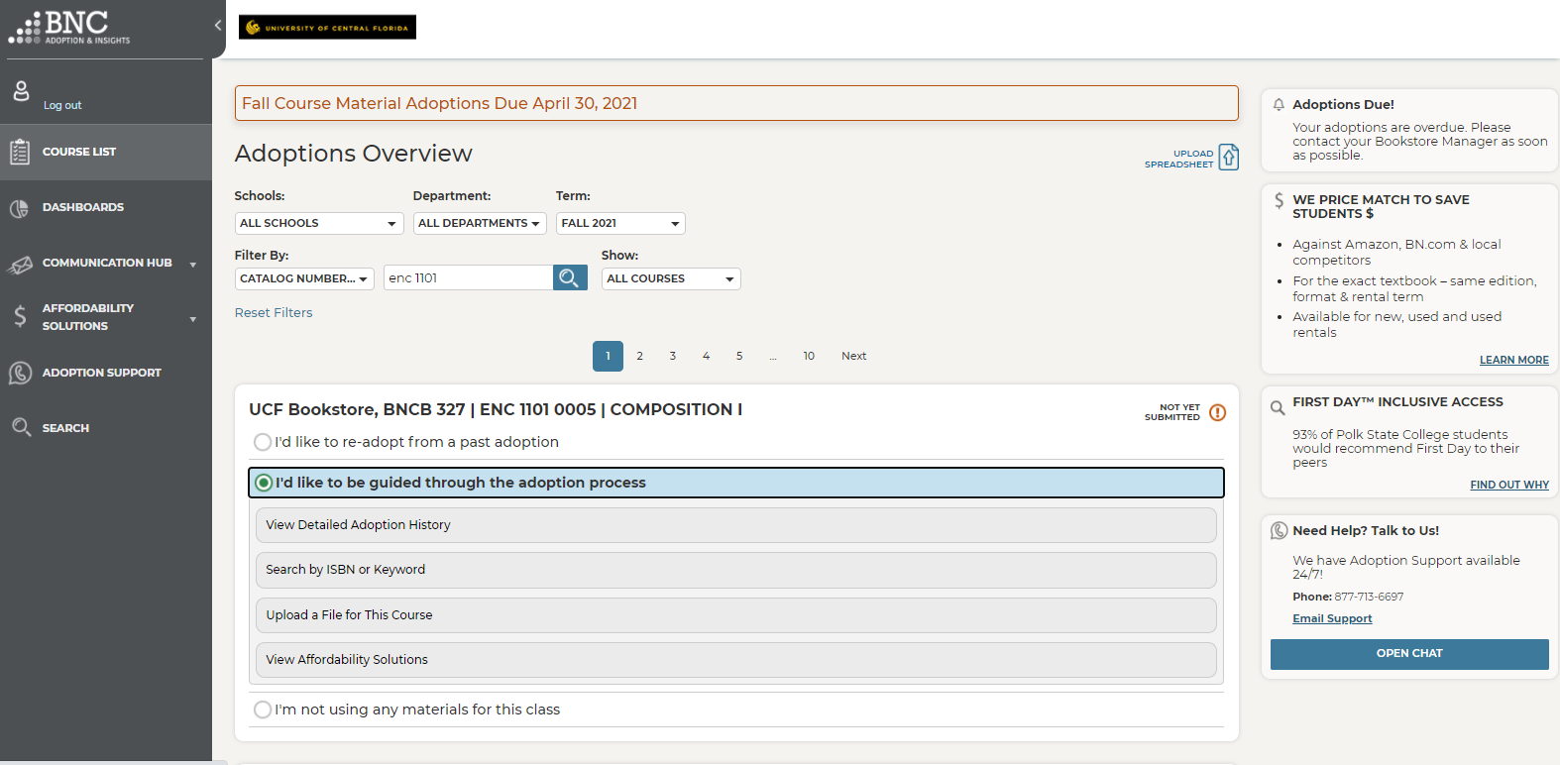
Adoptions & Insights Portal
Login to the Adoptions and Insights Portal (AIP) using your NID and NID Password
Click on Course List (Found on the left column of the page.)
Courses you are assigned to teach will be listed on the middle of the page.
Find the course you would like to adopt for.
Demo Video: https://www.youtube.com/watch?v=rTnuv7X63y8
UCF Campus Store

Slide 5
On Click Re-Adopt
To Re-Adopt from a past term, use the One Click Re-Adopt function
Select which term you want to use
Deselect any materials you don’t want to Re-adopt
If teaching multiple sections, apply your course materials to all or just submit one
Click Submit Adoption
That’s it!
UCF Campus Store

Slide 6
Guided Adoptions
To find new course materials, select the “I'd like to be guided through the adoption process"
View Detailed Adoption History by term, course, or professor
You can also Search by Keyword or ISBN
View textbook summary, pricing for students, and savings
Select if book is Required or Recommended
Click Add to Course to add as many ISBNs as you need before clicking Submit Adoption
UCF Campus Store

Slide 7
What are Open Educational Resources (OER)?
Open Educational Resources (OER) are free or low-cost teaching, learning, and research materials in any format and medium that reside in the public domain or are under copyright that have been released under an open license, that permit no-cost access, re-use, re-purpose, adaptation and redistribution by others”
(UNESCO Recommendation on OER, 2019).
Advantages of OER:
Empowering Instructors
With OER, you can adapt and customize learning materials to meet the needs of your students and your course’s learning objectives.
Save Money
OER allows students to save money, as OER textbooks and companion products are more affordable than traditional course materials.
Keep Content Relevant and High Quality
The open licenses of OER allow for sharing and continuous updates, to ensure the maintenance of quality and relevance of materials.
Flexibility and Choice
OER can be used as supplemental materials, but many instructors are increasingly using OER as their core course materials.
UCF Campus Store

Slide 8
Learn more about OER by exploring these solutions:
OpenStax publishes high-quality, peer-reviewed, openly licensed college textbooks that are free online and low cost in print.
MERLOT is a curated collection of free and open online teaching, learning and instructor development services contributed and used by an international education community.
OER Commons is digital library and collaboration platform for open license learning materials. Search, browse and evaluate resources in their growing collection of 50,000 OER.
Create Open and/or Free Educational Resources for Your Course(s)
Use the following tools to kickstart your content authoring experience:
If you would like to learn more about Open Educational Resources and Practices (OER/P), please visit https://cdl.ucf.edu/teach/oer-practices/ or
contact James R. Paradiso at james.paradiso@ucf.edu.
UCF Campus Store

Slide 9
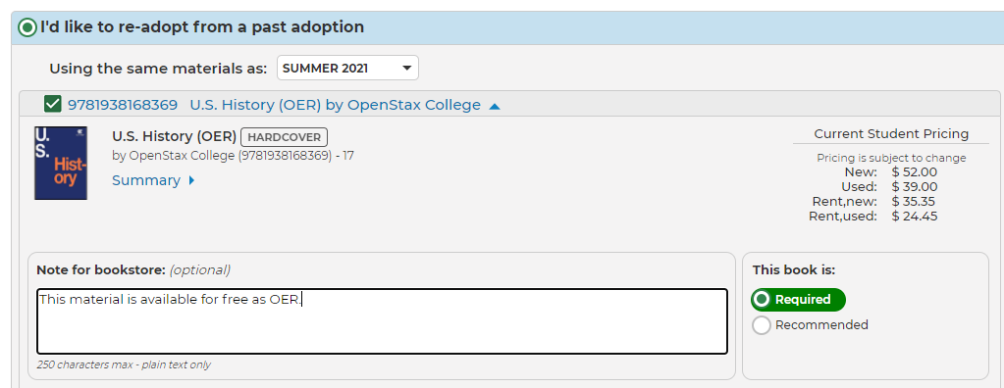
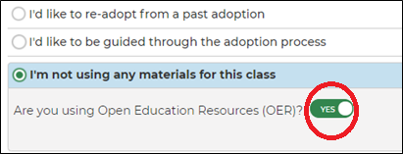
OER Adopted Materials
If the OER product has an ISBN, please adopt the OER ISBN.
Add this note for bookstore: “The digital copy is available for free ($0). Go to class first.”
To adopt OER that does not have an ISBN, please select “I’m not using any materials for this class” and move the toggle to “Yes” when prompted “Are you using Open Educational Resources (OER)?”
UCF Campus Store

Slide 10
UCF Library Sourced Materials
The UCF Library is a valuable resource for both faculty and students to support textbook affordability efforts.
The UCF Library can:
Locate unlimited-user eBooks as one-to-one replacements of existing course textbooks – with no cost to students.
Identify open educational resources and library-sourced digital materials (such as videos, articles, databases) as alternatives to commercially produced traditional textbooks.
For more information, please contact your Subject or Campus Librarian or the Textbook Affordability Librarian, Lily Dubach, at lily@ucf.edu
UCF Campus Store

Slide 11
UCF Library Sourced Materials
Do you use a library eBook? Please confirm with Lily Dubach (lily@ucf.edu) that the eBook will be available this semester.
If the product is available digitally through the UCF Library and has an ISBN, please adopt the book ISBN.
Select the “I’d like to be guided through the adoption process” option.
Enter your ISBN.
For student’s to be notified of this option when visiting the bookstore and website, add this note for bookstore: “This is free from the UCF Library. Go to class first.”
Click “Submit adoption”.
UCF Campus Store

Slide 12
UCF Library Sourced Materials
To adopt non-book UCF Library sourced materials (such as collections of journal articles), please use the “I’d like to be guided through the adoption process:
Select ISBN and enter: 2814078234919
Then select “To add this title, click here”
Enter “UCF Library” for the Title, Author, and Publisher fields. Then click “Add Title” and “Submit Adoption”.
The bookstore will mark the course as “Go to Class First” so faculty can give further instructions to students.
After the first semester adopted, the ISBN will appear in the course history and one-click adoption can be used in future semesters.
UCF Campus Store

Slide 13
No Materials Required
If your course is not using ANY course materials, then you can select “I’m not using any materials for the course”.
If your course is using any resources (OER, Library Sources, web-based programs, school supplies, etc. – even if the item is not sold through the bookstore), please submit the adoption through AIP.
Please contact the UCF Campus Store Textbook Department if you need assistance at 407-823-3355 or tm327@bncollege.com
UCF Campus Store

Slide 14
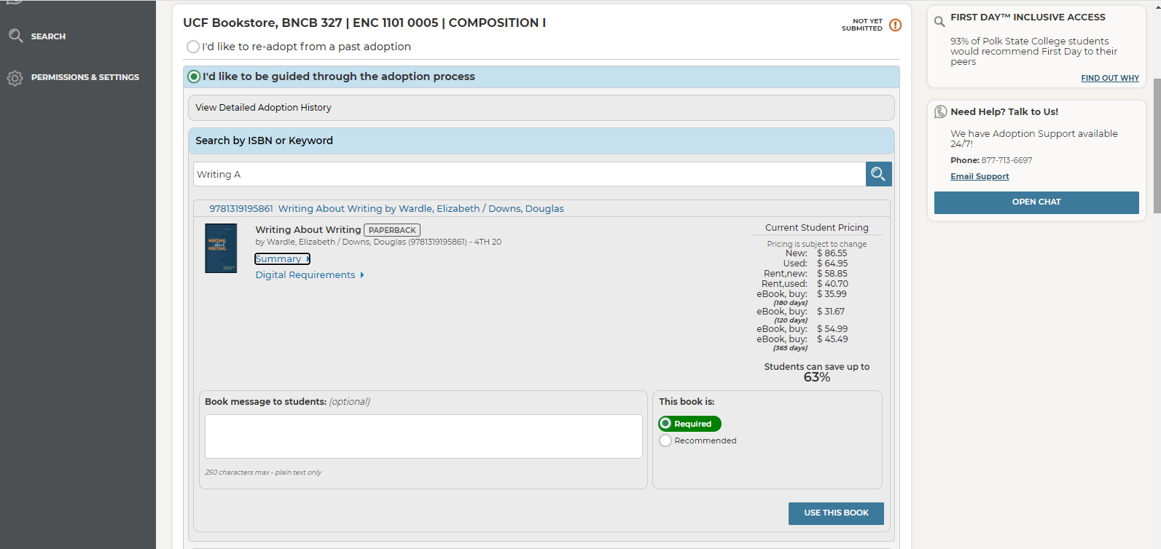
Confirming Materials
Click the box to confirm these materials will be used for the upcoming semester.
Click Submit
UCF Campus Store

Slide 15
UCF FIRST DAY ADOPTION PROCESS
After adopting your course materials in AIP

Slide 16
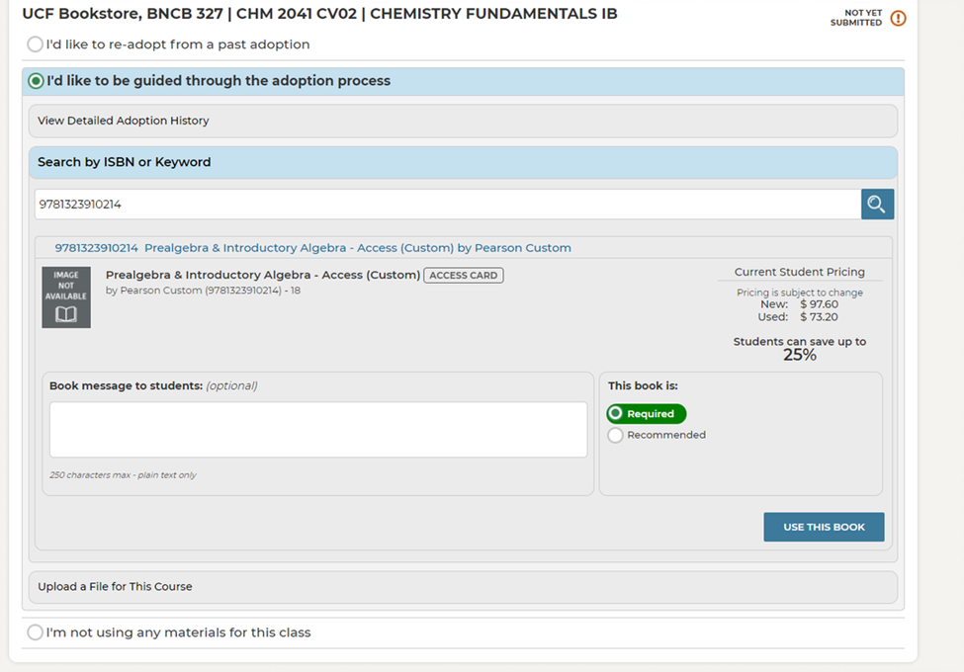
Click on "I'd like to be guided through the adoption process"
Click- Search by ISBN or Keyword
Type in the ISBN
Please note: Do not use the IA ISBN- the IA ISBN is used between the publisher and bookstore only.)
Click Search- The title will appear.
Choose if the material is required or recommended.
Click on "Use this book"
Click "Submit Adoption"
Click on "I'd like to be guided through the adoption process"

Slide 17
First Day
Complete the Inclusive Access Adoption Form https://forms.office.com/r/KVRcSqL2cy to confirm your participation in First Day and the course materials being used.
Please see the list of participating publishers on the UCF CDL First Day page: https://digitallearning.ucf.edu/ilab/aim/first-day/
All materials have to be vetted for availability and pricing for the First Day Program.
Materials will be available for Opt-In, three weeks before the semester begin. Please check your Course Materials screen early to verify setup.
The Opt-In deadline is UCF’s Add/Drop deadline.
Please include sample messaging provided in the First Day Instructor Guide in your syllabus or as an announcement in Webcourses@UCF. It is important to include messaging for third-party billing students.
Participating in the First Day program allows your students to have access a deeply discounted option for their required course materials.

Slide 18
Thank you
Need AIP Help? Talk to Us!
We have Adoption Support available 24/7!
Phone: 877-713-6697
Contact Affordable@ucf.edu or visit https://digitallearning.ucf.edu/ilab/aim/ to learn more about affordable instructional material options at UCF.
UCF Campus Store Support
By Phone (407) 823-3355
Email: tm327@bncollege.com

